Slide 1

Specialist Autism Team hospital discharge pathway
The Specialist Autism Team (SAT) offer a hospital discharge pathway for in-patients, with an Autism diagnosis, transitioning from AMH wards to community.
If this pathway is required, the patient will need to consent to working with SAT. Once consent is gained a referral can be made on System One using the “refer to LD SPOA” button, see overleaf. This referral should be made two weeks before discharge. Once the referral is received SAT will attend the ward rounds. All that is needed on the referral is a brief sentence such as “We have spoken to the patient, and they have given verbal consent to work with SAT. Please accept this referral for the discharge pathway”
SAT can pick up patients two weeks before discharge, so once the referral has been made, please send ward round invites ward rounds to dhcft.derbyshiresat@nhs.net and a team member will attend.
Please see the information leaflet below which can be given to the patient to explain SAT’s role and help inform consent. For any queries, please email on the above address or telephone 01246 565062 or 07867 286458.

Slide 2
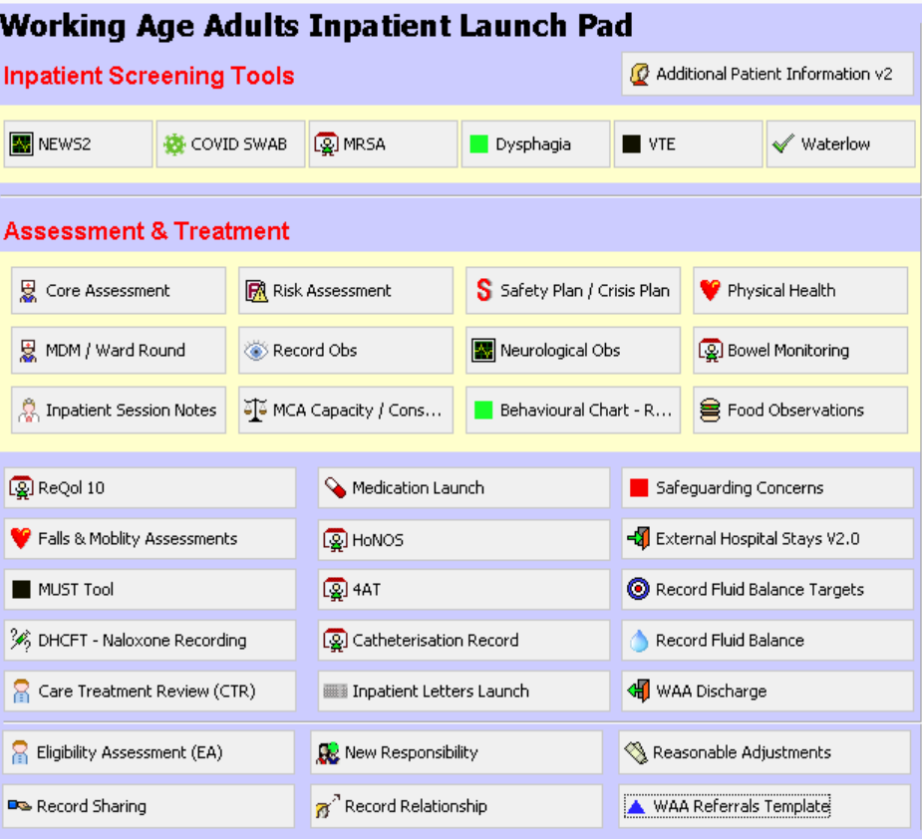
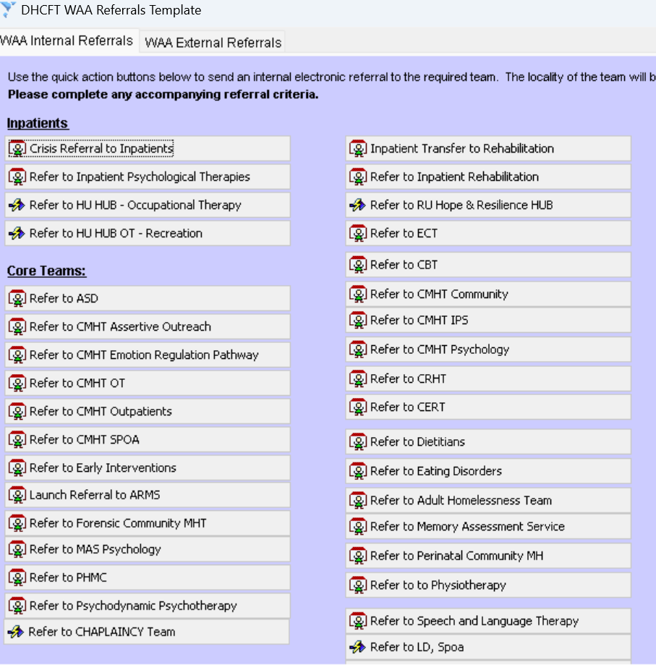
Specialist Autism Team System One referral process
To refer to SAT use the Inpatient launch pad and click the following links.

